Slide 1
Discrete Random Variables

Slide 2
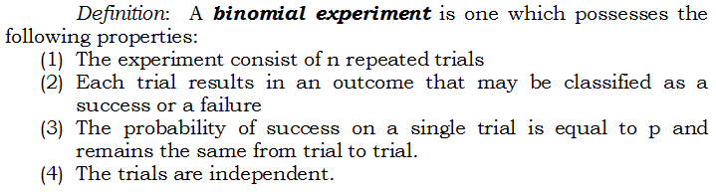
Binomial Distribution

Slide 3
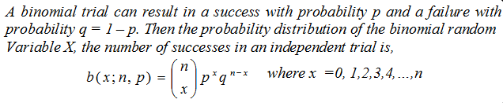
Binomial Distribution

Slide 4

Examples

Slide 5
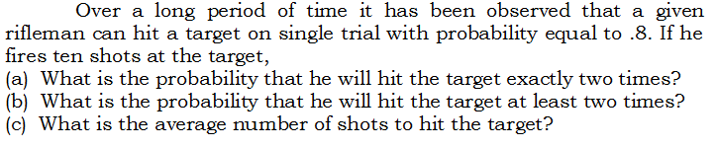
Example

Slide 6
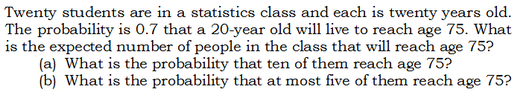
Example

Slide 7
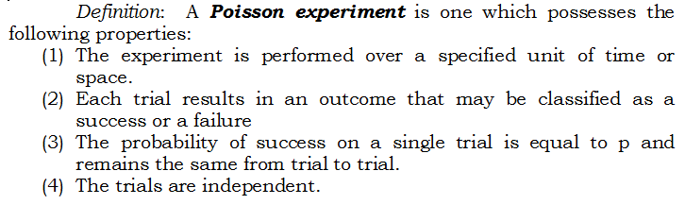
Poisson Distribution

Slide 8
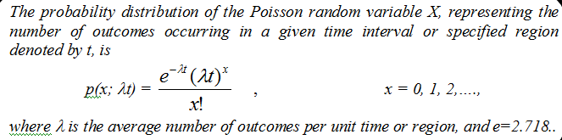
Poisson Distribution

Slide 9
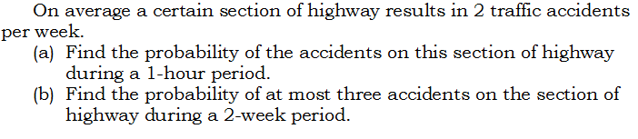
Examples

Slide 10
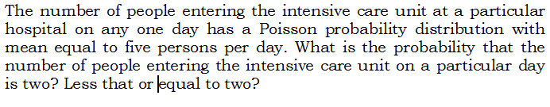
Examples

Slide 11

Examples

